Slide 1
Creating/Remembering Secure Passwords
Hain-Lee Hsueh
Michael Duong

Slide 2
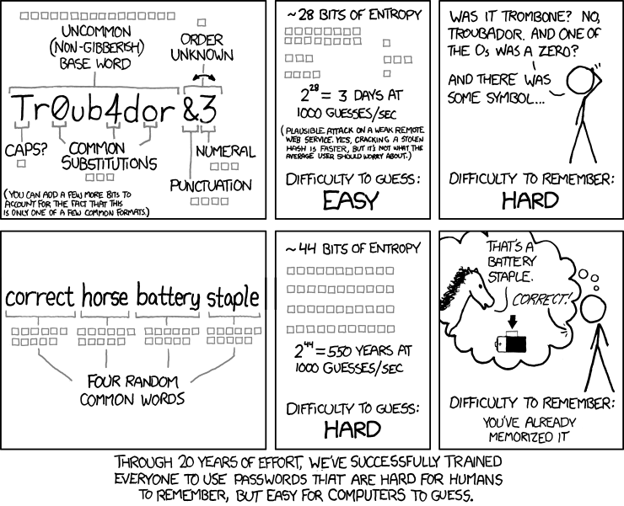

Slide 3
Secure And Memorable Passwords
Problem:
Maintaining many random passwords is difficult to remember: BAD
Maintaining a single master password is extremely insecure: BAD
Short passwords utilizing common words: BAD

Slide 4
Secure And Memorable Passwords
Possible Elaboration Strategies
Leverage personal word associations within the password (chunking)
Create a mental visual or story of the password that only makes sense to you
Establish an obscure but memorable connection between password and the thing being protected
Example
PW for an amazon account: samtoucanfruitgoods

Slide 5
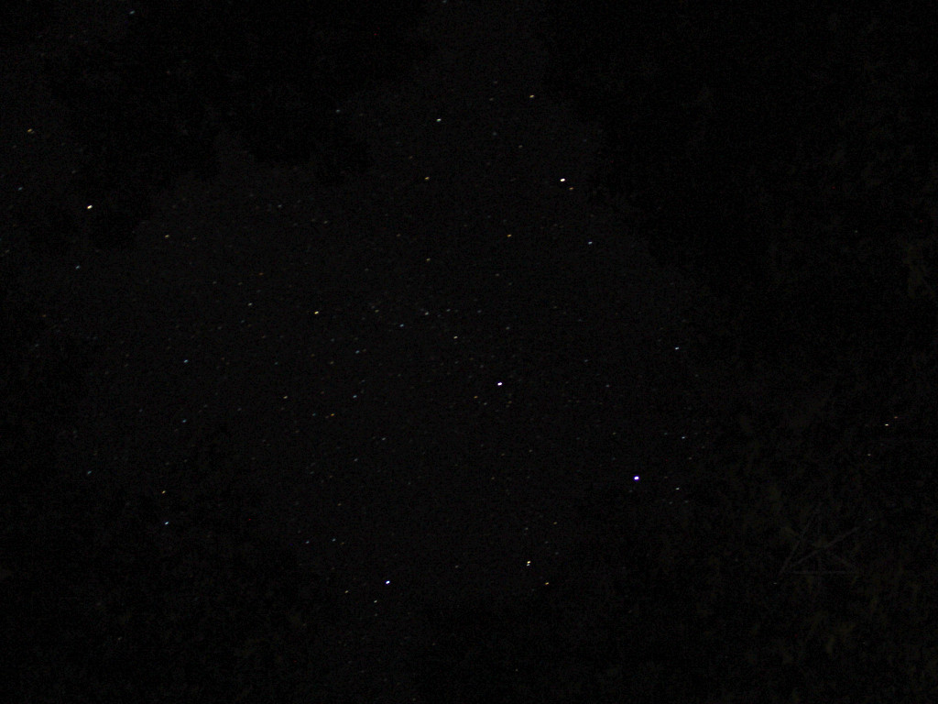
A long time ago in a galaxy far, far away…

Slide 6

STAR WARS
Securing the New Hope

Slide 7
Rebel spaceships, striking from a hidden base, have won their first victory against the evil Galactic Empire.
In anticipation of the empire striking back, the rebel forces decide to re-secure their galactic infrastructure to avoid enemy infiltration.
You have been tasked to manage security access to all of the rebel forces’ vital resources. This entails creating memorable yet secure passwords to guard against unauthorized breaches, and granting access to legitimate entities.
May the Schwartz be with you.

Slide 8

Core Mechanic
You are captain of the command center, from which you can oversee all of the rebel resources hovering in space
E.g. weapon chambers, food reserves, infirmary ships, refueling stations, money vaults, docking stations, super laser control rooms
Initially, all resources are unlocked; you need to create a distinct password to protect access to each resource
During game play, additional resources (e.g. new food reserves) may be introduced that need to be secured

Slide 9
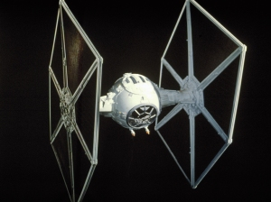

Core Mechanic
Galactic Empire ships are trying to compromise rebel resources; you must lock each resource (by creating a secure password) before enemy ships reach them
Failure to do so will result in a hostile takeover of the rebel forces, and captivity in carbonite

Slide 10
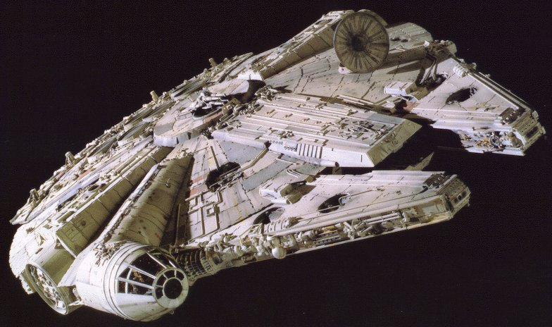
Core Mechanic
Concurrently, rebel ships periodically need legitimate access, which you grant them by providing the password upon each request
You get three attempts per resource to enter the password before the resource is indefinitely locked
Failure to do so will result in exile to the distant planet of DANtooine*
*Real Star Wars planet: http://en.wikipedia.org/wiki/Dantooine#Dantooine

